Slide 1

Customer Feedback Analysis & Insights
Report By
Data Science Team

Slide 2
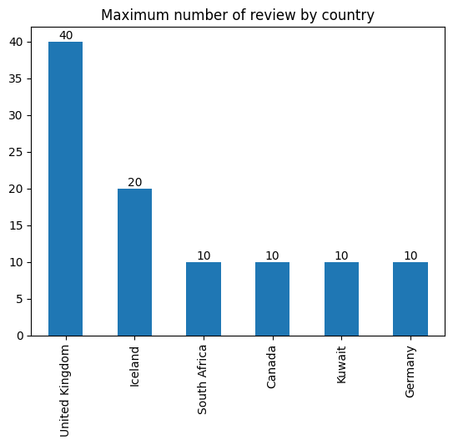
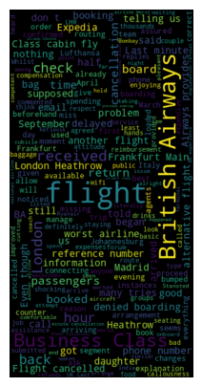
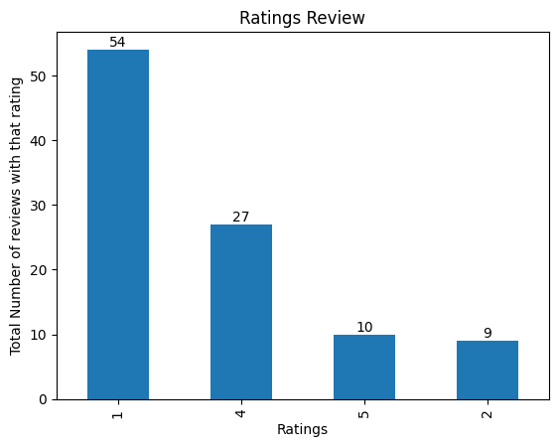
Buzzwords in reviews
Average Rating 2.3/5
Total Reviews
100
Countries in Dataset - 6

